Slide 1
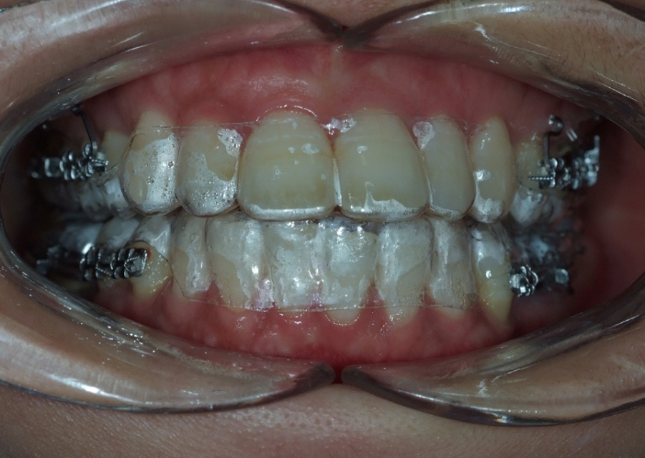
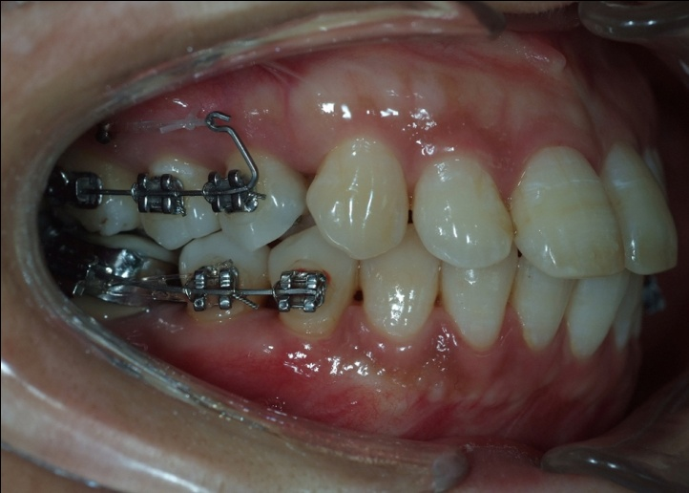
Clear aligner for
anterior teeth
Fixed appliance and Microimplant
for posterior teeth

